Slide 1



CatSat Ground Station Software and Communications
Augie Jimenez, Jacob Padilla
Mentors: Dr. Chris Walker, Dr. Mike Parker
Department of Astronomy and Steward Observatory
April 17, 2021
Virtual Space Grant Symposium
Notes:
Note to jacob, I don’t think mike is technically a mentor but it’s probably fine to have him here either way

Slide 2
CatSat Background
The main objective of CatSat is to characterize and demonstrate RF transmission through the FreeFall inflatable antenna
The secondary objective is to Capture and record HD video frames using the Metrology Camera and transmit data to the ground through X-band antenna
The tertiary objective is to Collect HF HAM signals and transmit HAM data to the ground through X-band antenna

Slide 3

GOMspace Hardware
Nanomind A3200 - On board computer and Attitude Control and Determination System for CubeSat
NanoCom MS100 - Command and Management unit used for communication between ground station and CubeSat computers
NanoCom GS100 - Radio that communicates from the ground to the satellite using Ultra High Frequency

Slide 4

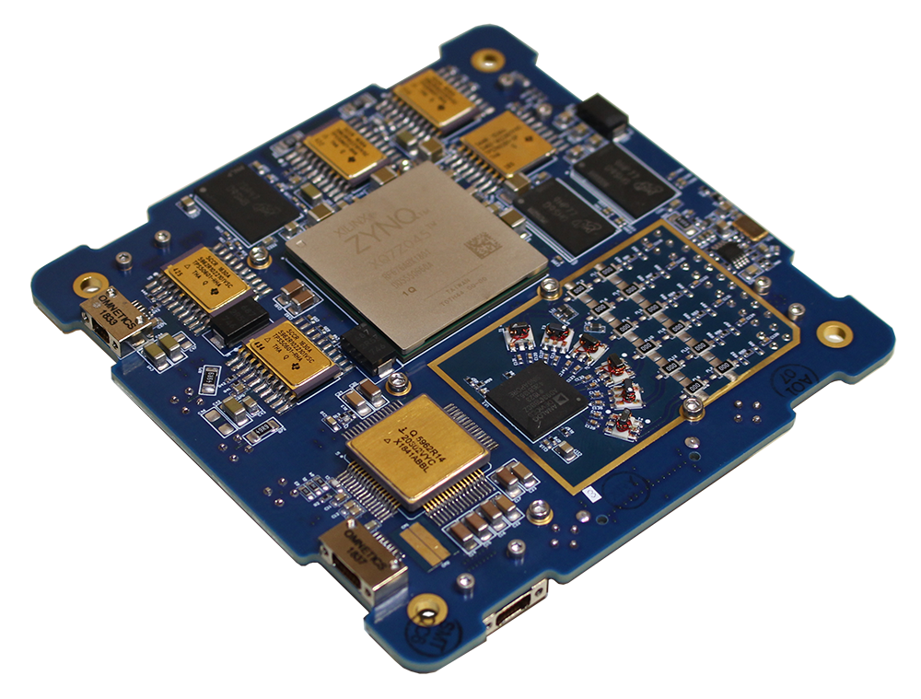
Rincon Research Hardware
AstroSDR - Board with radio that communicates the data between the CubeSat and the ground station
Radio Ranch Antenna - antenna to receive UHF radio signals in Tucson from the satellite
Radio Ranch Ground Station - Computer connected to the antenna, which acts as a ground station and also relays data to the main Ground Station at Drake

Slide 5
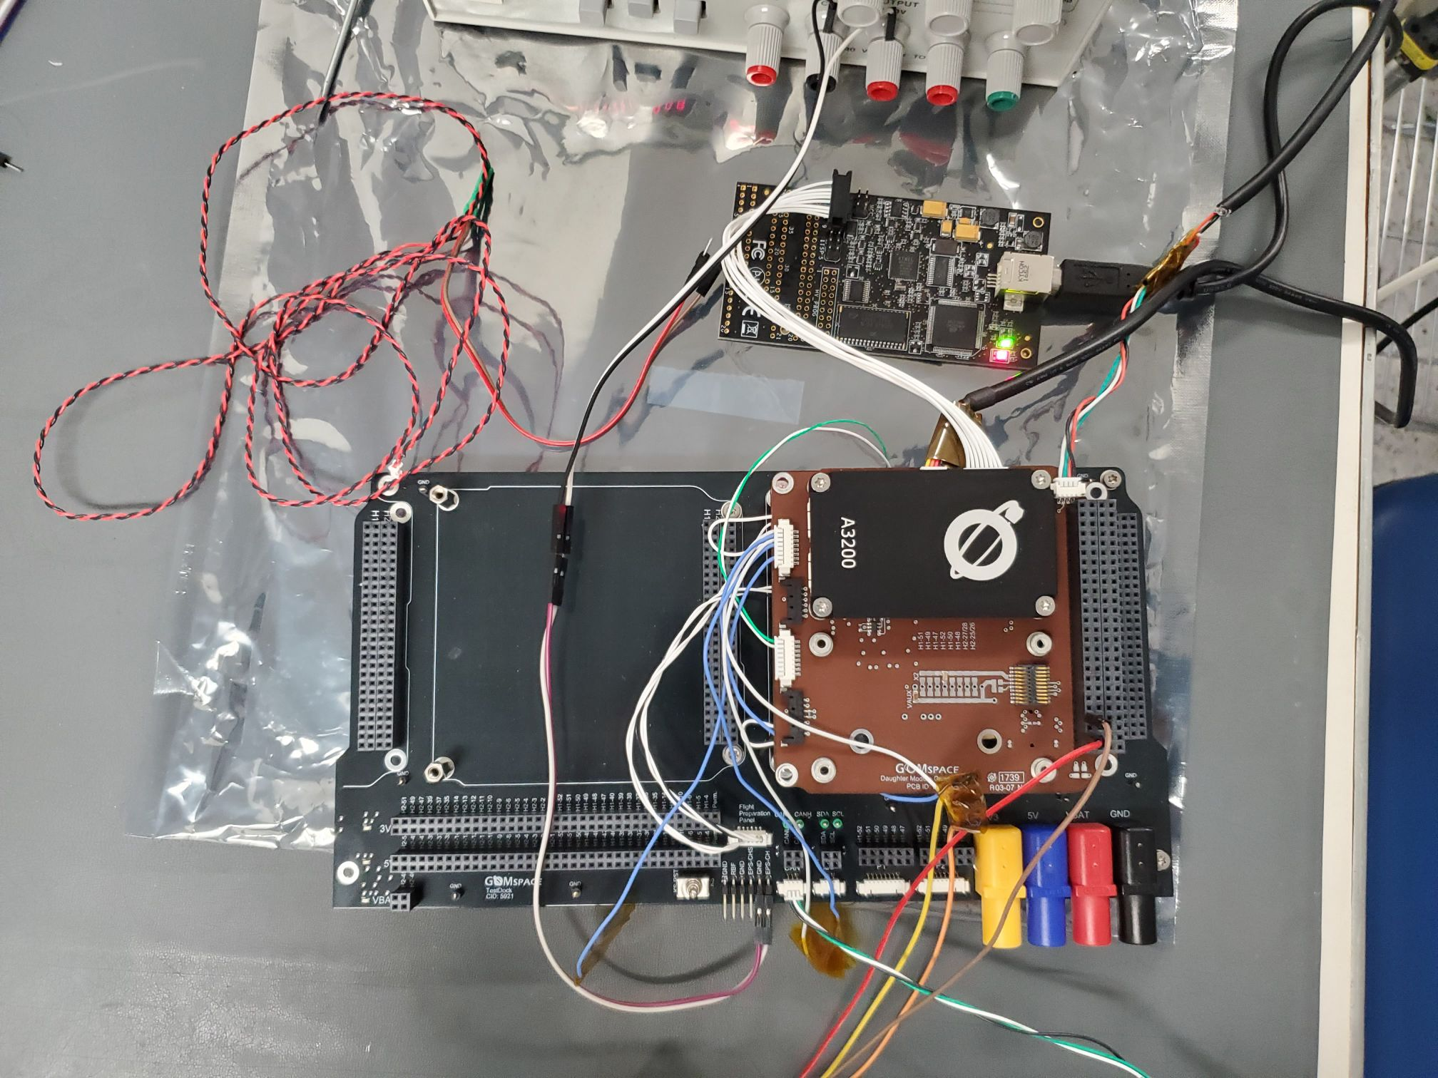

Slide 6
Our Objectives
Establish functional communication between core components of FlatSat and the ground station
Be able to store/change/retrieve parameters (Housekeeping), and clock set/get from the ground station

Slide 7
Why is it important?
Housekeeping packets must be sent and received so that onboard instruments are functioning as intended.
Clock time is reset when the CubeSat goes offline/restarts, so keeping this synchronized is useful in keeping track of when each packet is sent/received
Notes:
Such as attitude determination and control system, metrology camera, inflatable antenna

Slide 8
Debugging
Housekeeping parameters from CatSat need to be stored/edited/retrived
Need to maintain GOMSpace’s format and syntax
Break down each individual function to better fit each parameter to the housekeeping packets
Notes:
Bullet points, cleanup.

Slide 9
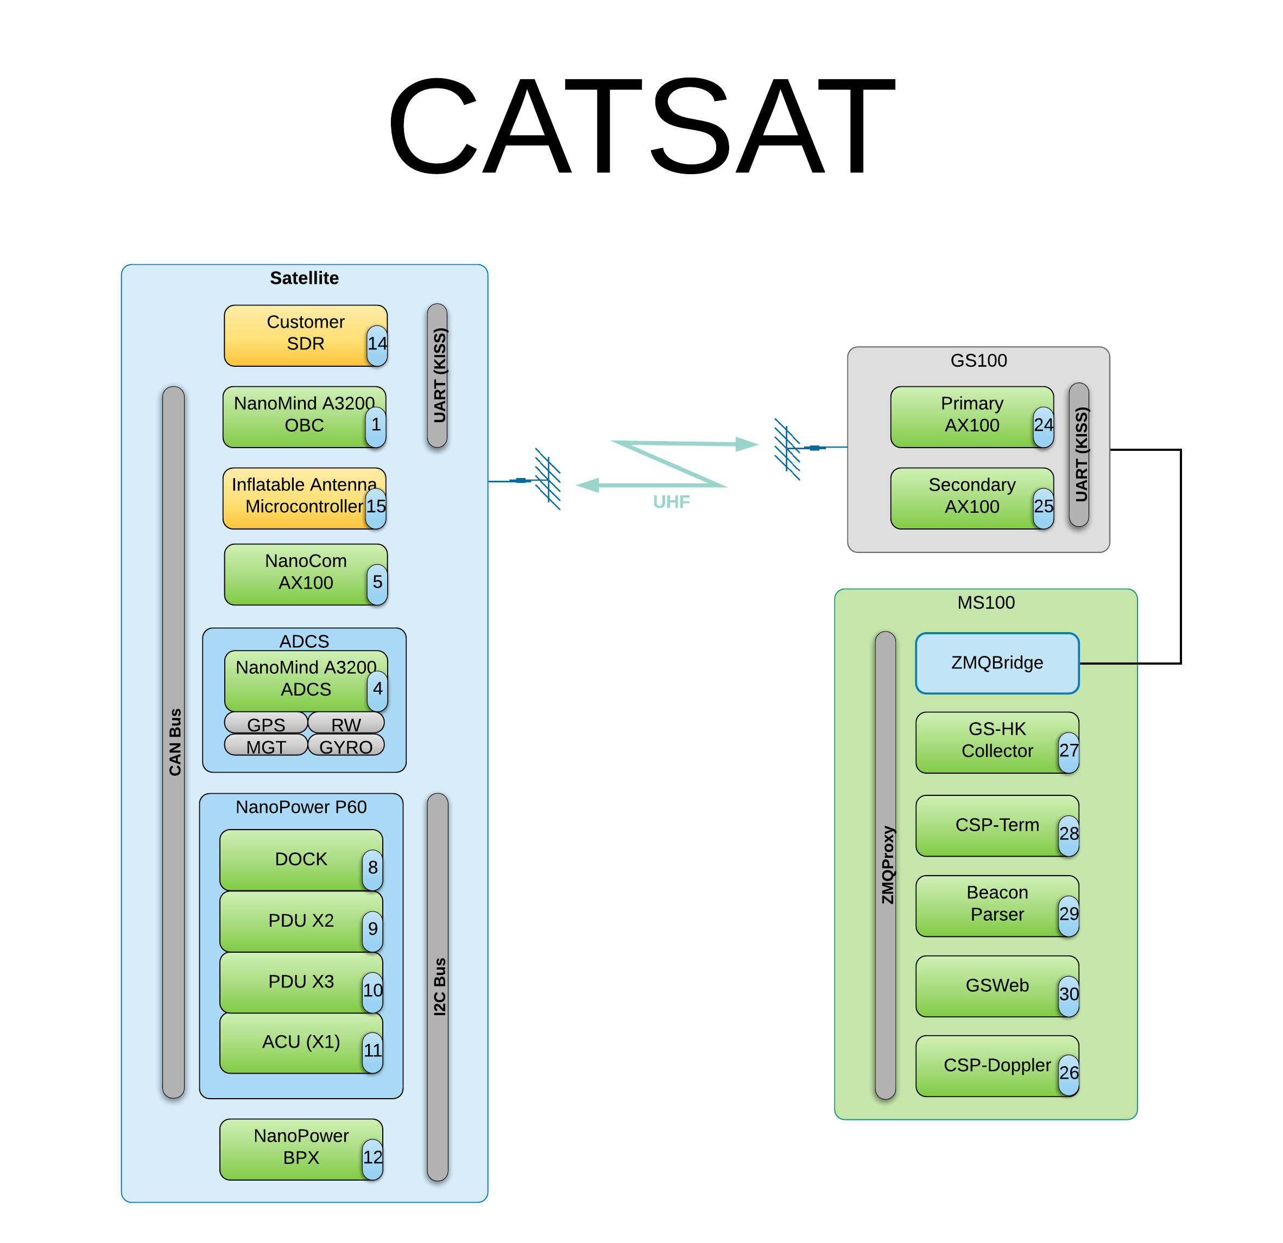
Notes:
MS100 connects to Ground Station to use UHF radio signals to connect to the satellite. This radio connection interacts with the inflatable antenna, which uses the CAN bus to connect to the rest of the satellite’s components (excluding power)

Slide 10
Address | Parameter Name | Parameter Data Type | Parameter Value
0x0000 | uid | STR | “”
0x0010 | type | U8 | 0
0x0011 | rev | U8 | 0
0x0012 | dock_type | STR | “DMC3”
0x0022 | csp_addr | U8 | 1
0x0023 | csp_rtable | STR | “14/5 KISS, 12/5 CAN 8, 16/1 CAN 24, 0/0 CAN”
0x0083 | gosh_en | BL | true
0x0084 | gosh_uart | U8 | 2
0x0085 | can_en | BL | true
0x0088 | can_brate | U32 | 1000000
\
Notes:
This code is defining the new set of parameters we added, and it includes things like the clock time, temperatures of computer components, etc.

Slide 11
Conclusion and Future Work
Flight computer is able to downlink packets to the ground station
Communication is established between the AstroSDR and the onboard flight computer
Housekeeping packets are being sent and received from the AstroSDR
The next step is to configure the camera to transfer files to the AstroSDR and downlink them to the ground station
The development of the ground station software will be reusable for any future CubeSat projects, which should save time and resources

Slide 12
Acknowledgements
Thank you so much to….
Dr. Chris Walker and Dr. Mike Parker
Del Spangler
GOMspace and Rincon Research Corporation
Michelle Coe
Arizona Space Grant Consortium

Slide 13
Thank You!

